Slide 1

POLLOS
HERMANOS

Slide 2
GOALs
After the tragic death of former CEO, Gustavo Fring, Los Pollos Hermanos has decided to re-invent their identity and have a wider approach at costumer opening it’s doors to the youth community.
They’ve been advised to hire an UX and UI team to re-design their site and they’ve taken the opportunity to, also, change their menu.

Slide 3
Pain points
UI team has created a design system for the site so that it has a cleaner styling. Unfortunately your UI team member (Jesse Pinkman) went missing so you have no access to resources.
They wanted to make it effortless for costumer to view or even buy their products with as few clicks as possible.

Slide 4
YOUR WORK
As a FED they want you to have a clean, well documented code that takes emphasis on atomic design and is as pixel perfect as possible.
Use Angular 6, TypeScript, Sass and bootstrap to achieve your goal.
DEFINE
SUPPORT
REFERENCE
Define your tags, plan ahead your work. Find your back-end provider.
Ask for help if there’s any doubt.
Document and keep track of your tasks using Trello.

Slide 5
WEB VIEW

Slide 6
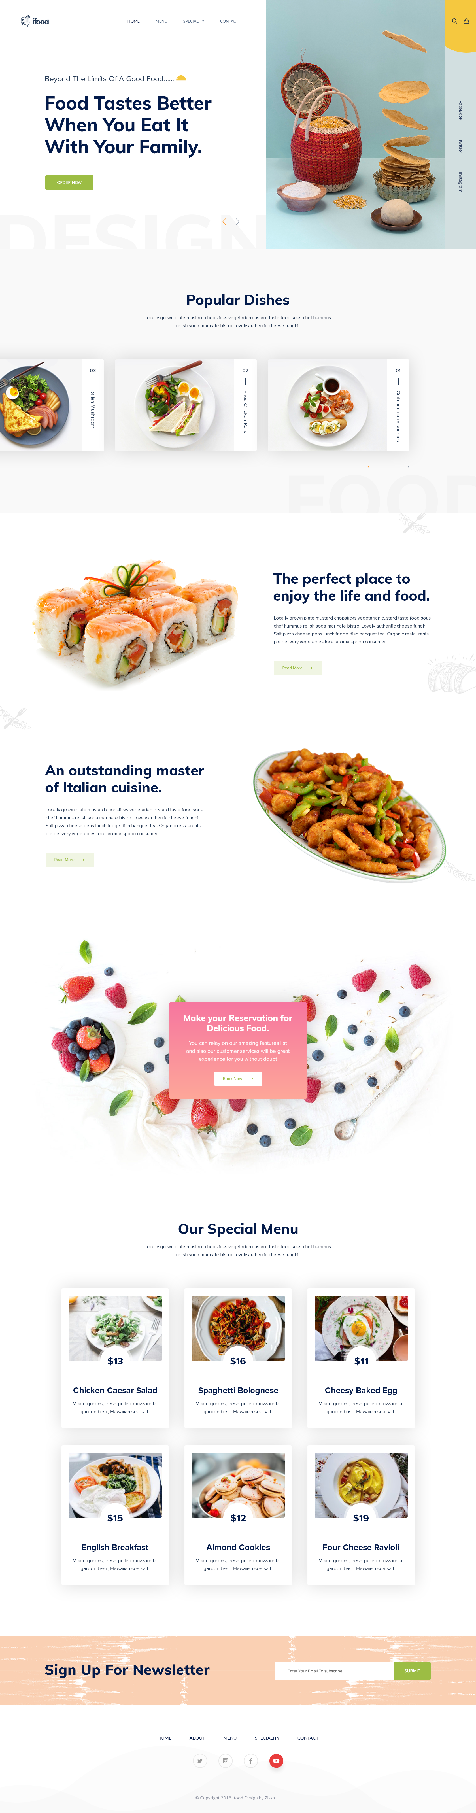
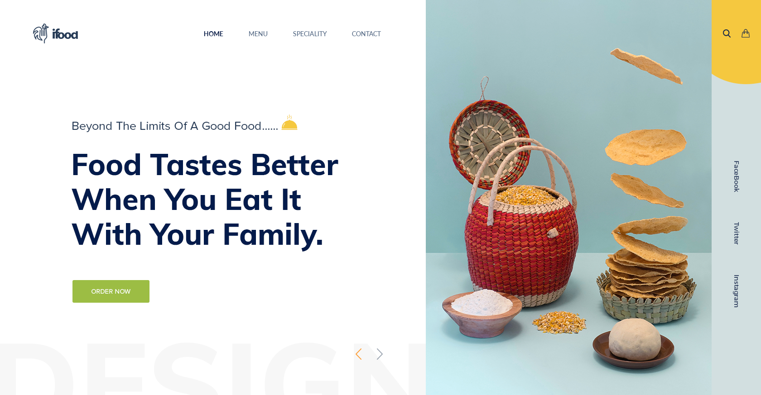
col-md-7
col-md-4
col-md-1
Header

Slide 7
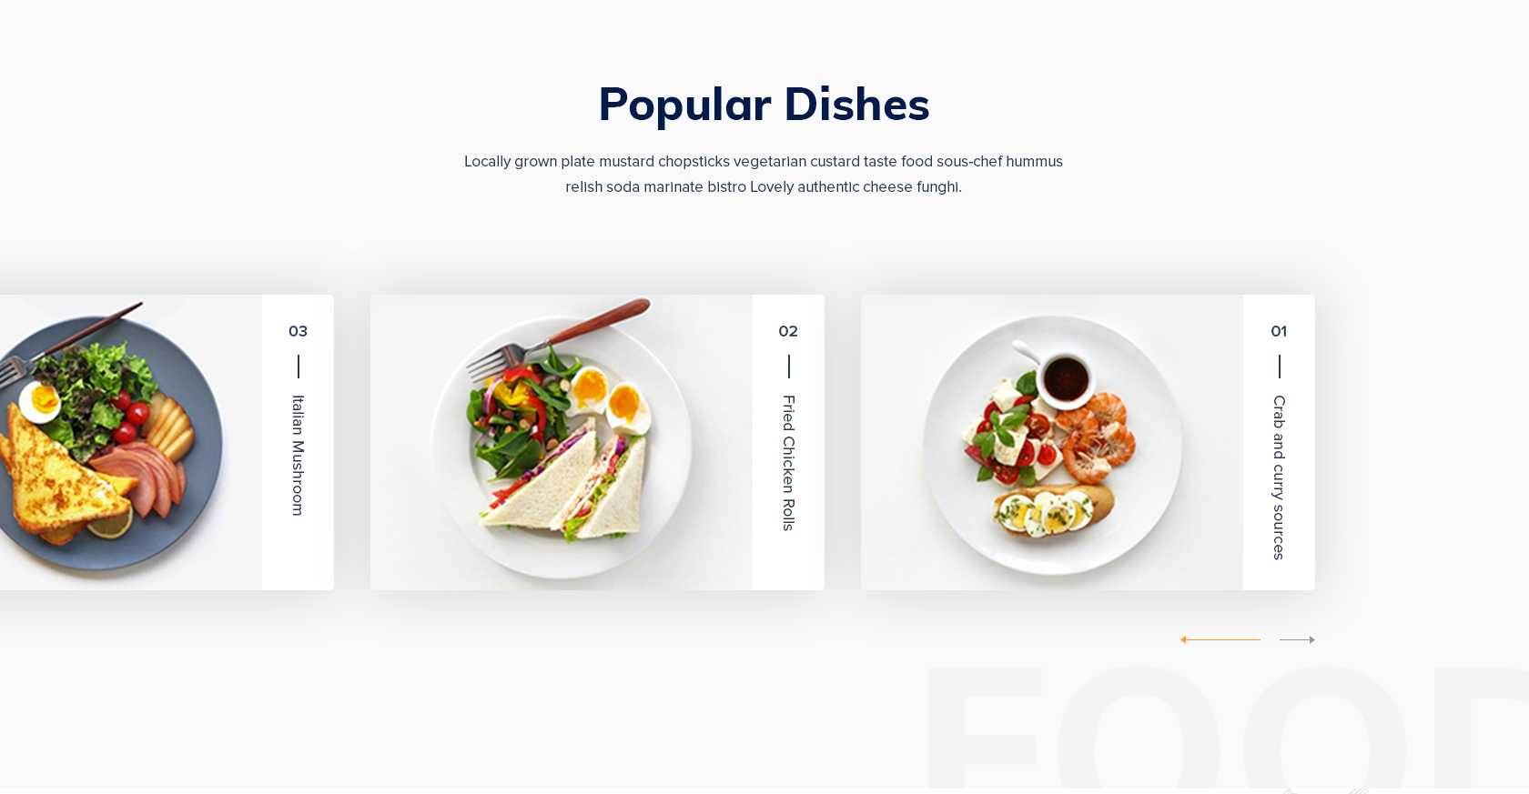
container
row
card
card
card
row
BS? JS?

Slide 8
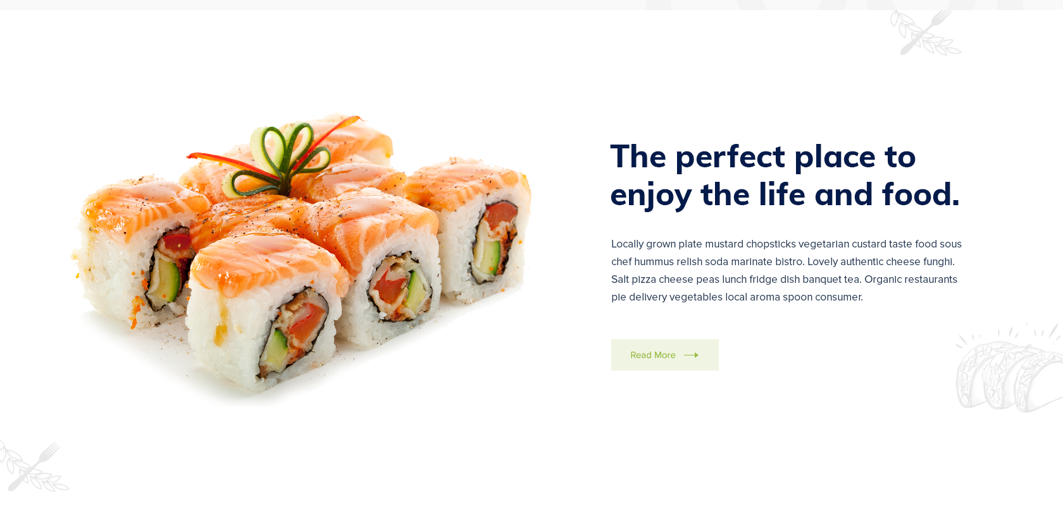
container

Slide 9
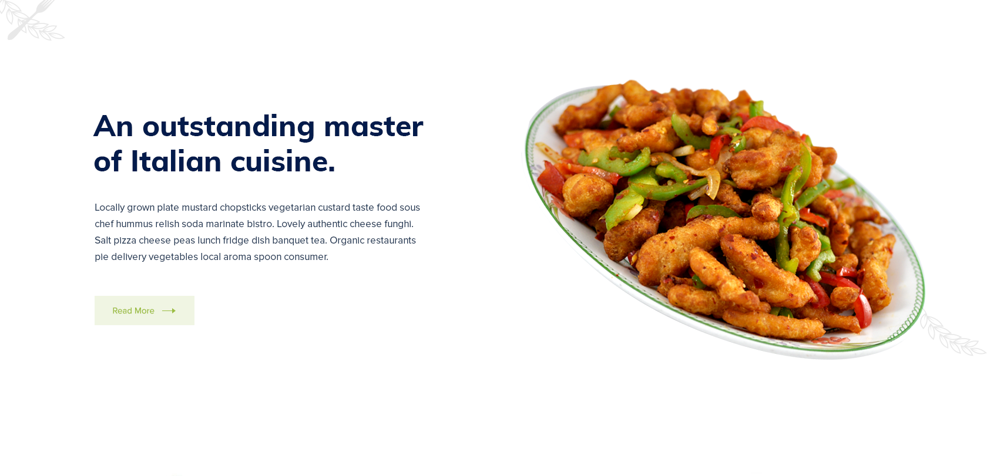
container

Slide 10
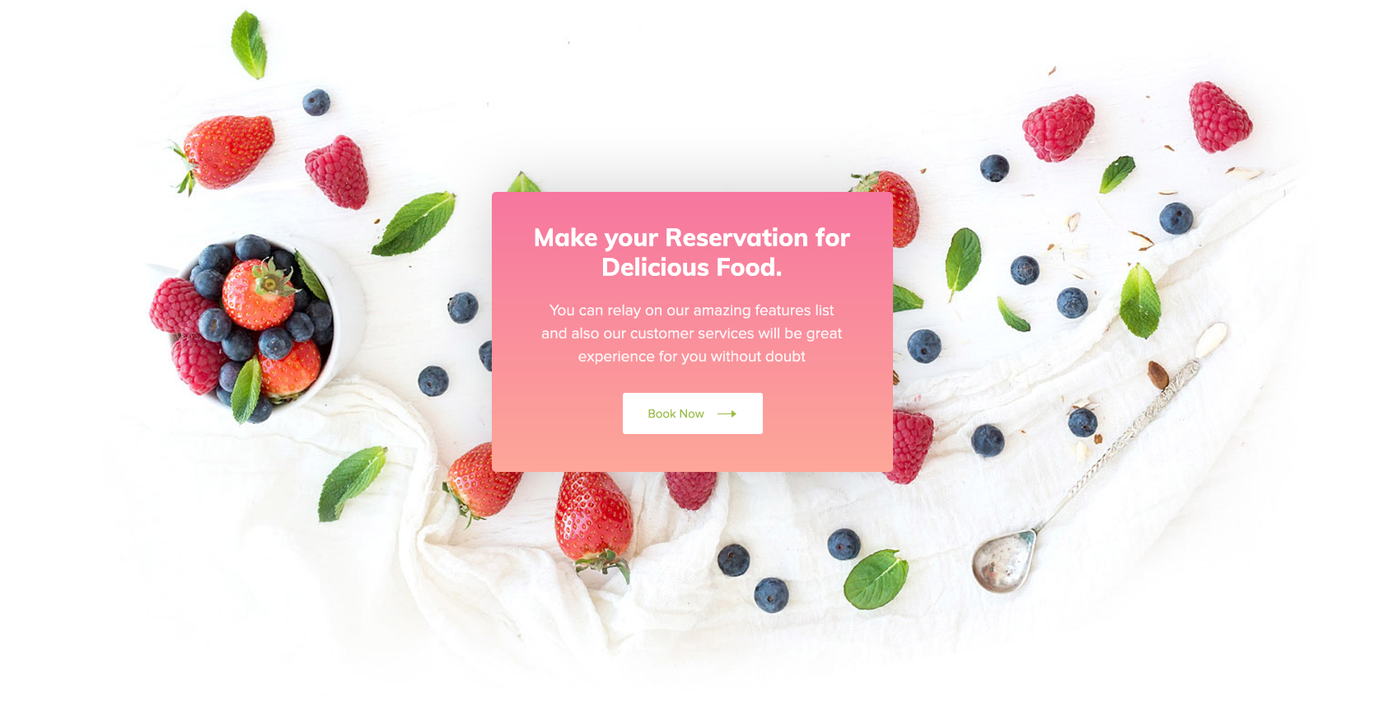
card

Slide 11
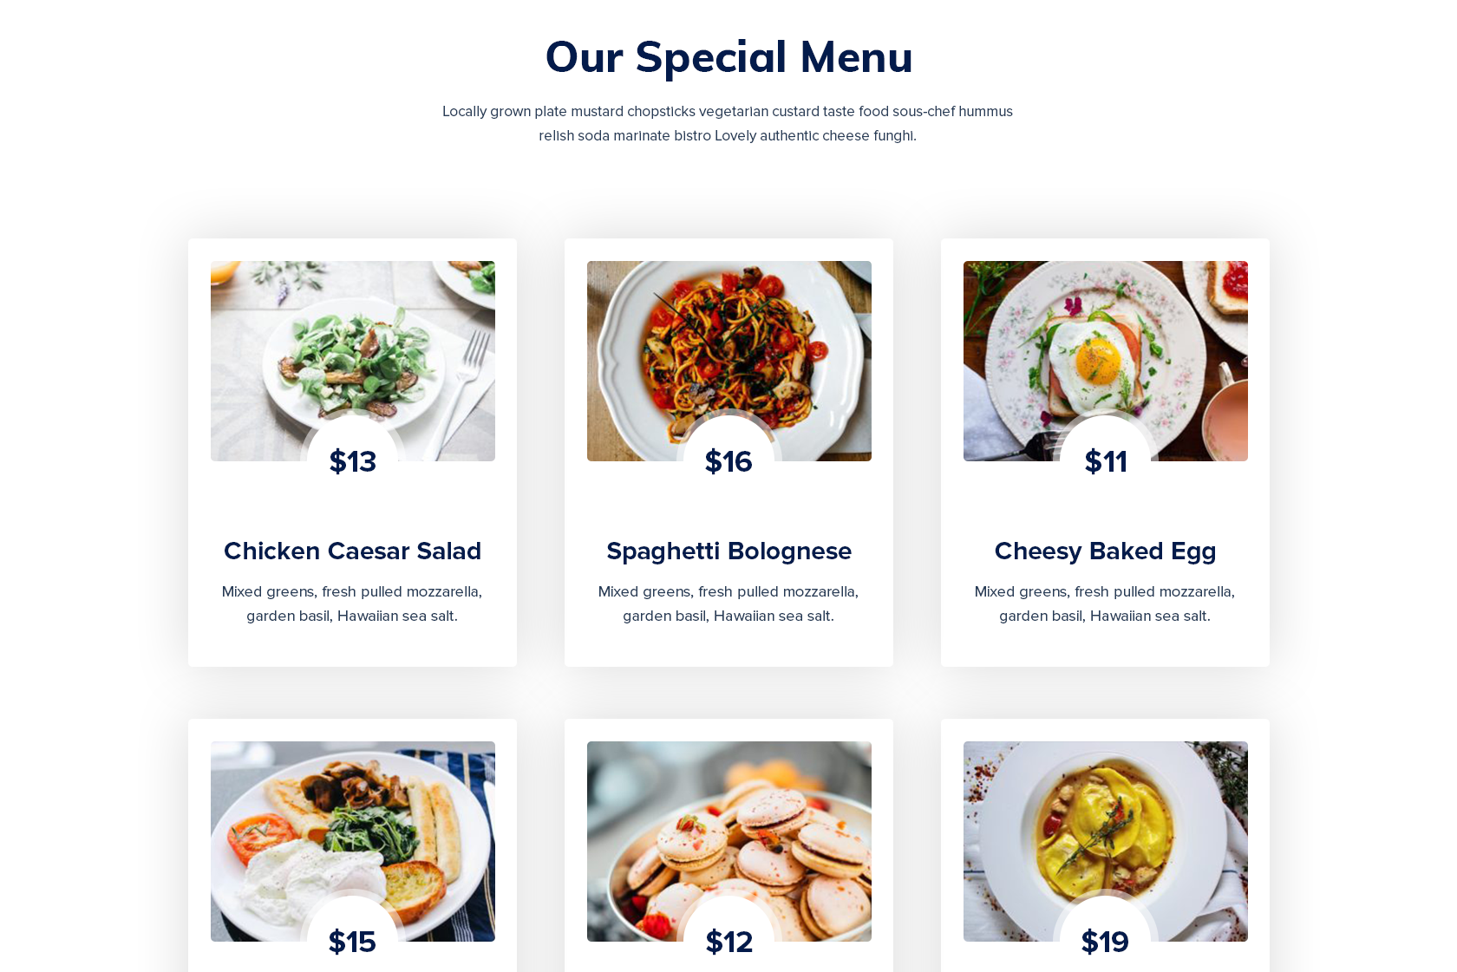
card
card
card
card
card
card

Slide 12
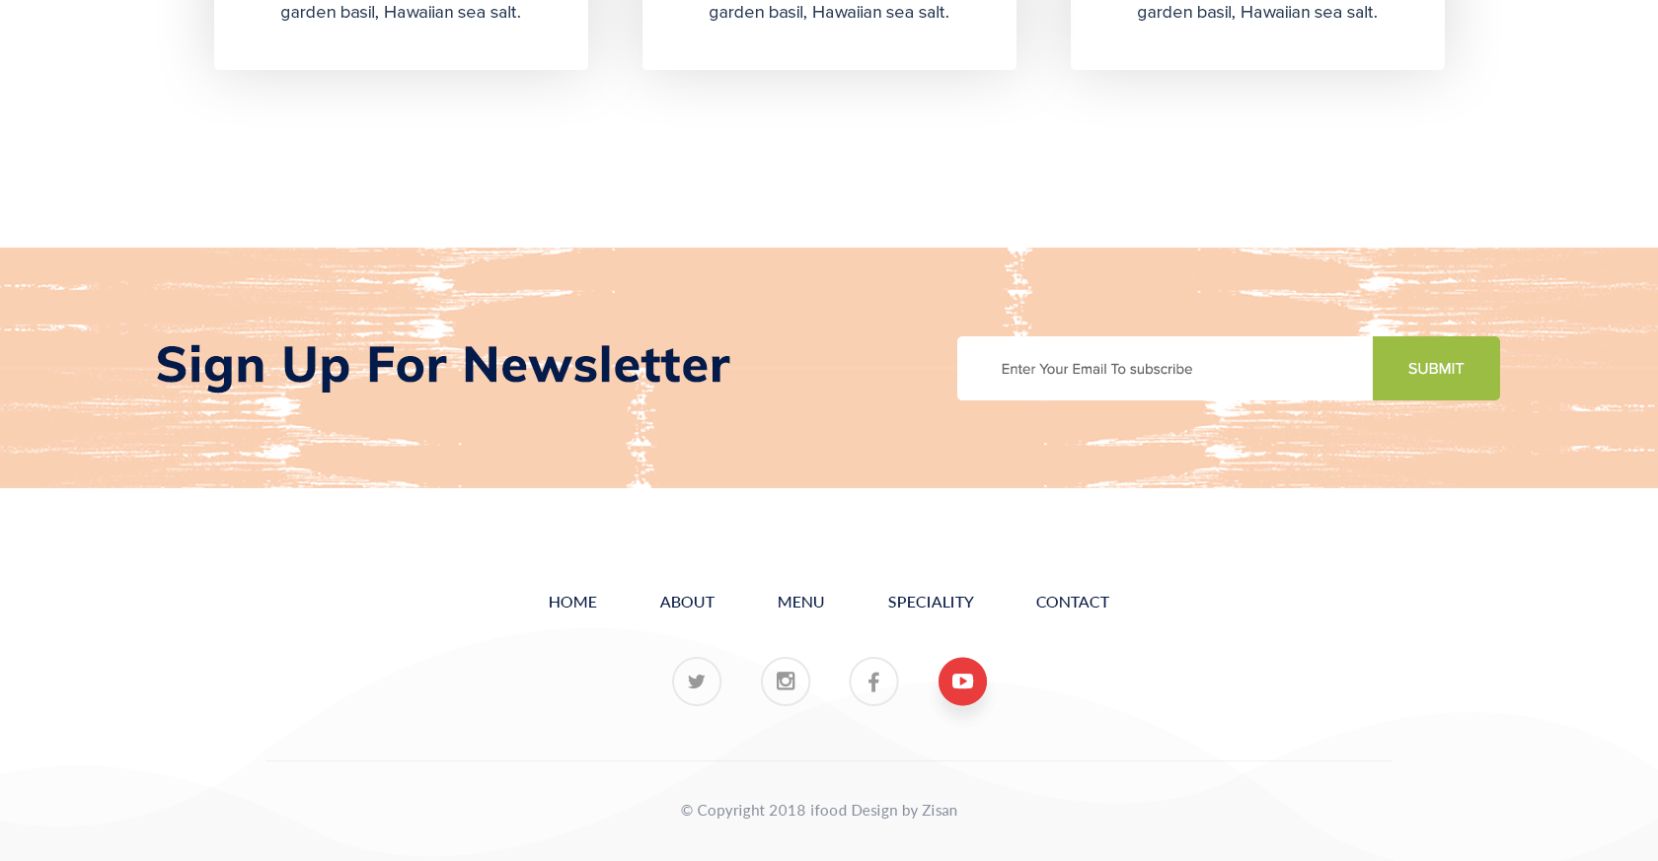
card
card
card
footer

